Slide 1
Where did all the tandem instructors go?
Tandem Instructor Retention Survey
By Angie Aragon
March 2023

Slide 2
About Angie Aragon
Skydiving History
Skydiving 2006, Skydiving Instructor since 2011
Tandem/Coach Examiner since 2017, AFFIE on Dec 2022
Home DZ’s: Skydive Perris & Skydive Chicago
7,000+ skydives, 4,500 tandems
Approx 45 Tandem Instructor Rating courses taught to date
Worked with just shy of 100 candidates over the last 6 years

Slide 3
Understanding the problem
Lack of available tandem instructors | New tandem instructors | Experienced tandem instructors
2 Types New tandem instructors Experienced tandem instructors | USPA Statistics 25% of those that received their rating did not renew after their initial 12 month period | Over 60% do not renew after year 3 Average life cycle is 3 years (carries over to all skydiving) Why does that happen and how can we change that?

Slide 4
Survey Question: What is the most challenging part during your early days as an instructor?
Mentorship
Not having anyone to help get through the learning curve
Wind Conditions
Flow
Being expected to jump in weather conditions that were above my skill level
Being rushed to make more jumps than I was ready to make
Passenger
Taking pax that were of challenging body types early on (i.e. tall, elderly or pear shaped)
Does a momma shark have to teach a baby shark how to hunt?

Slide 5
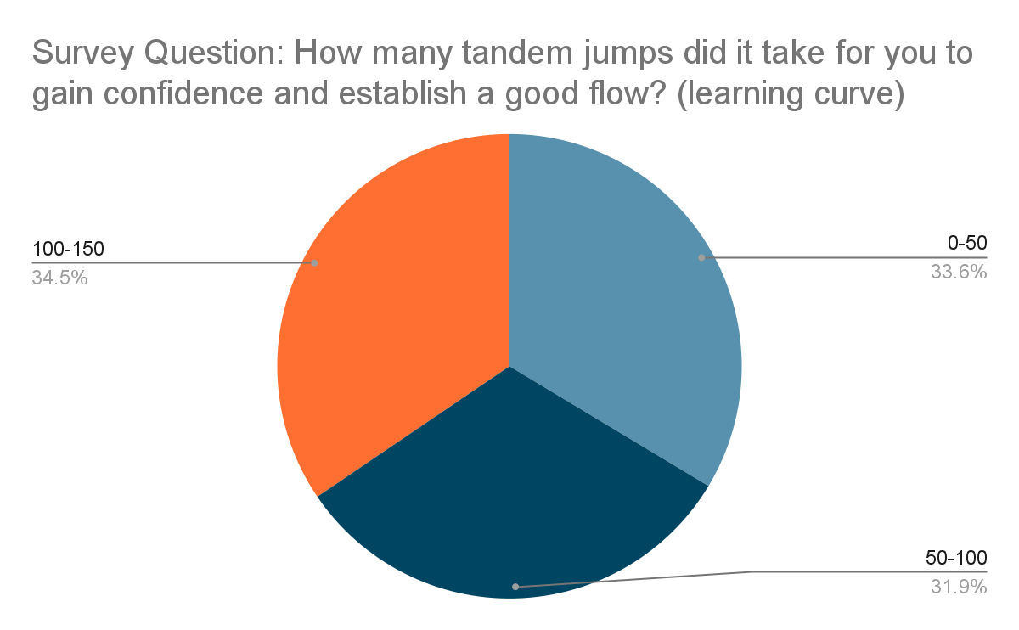

Slide 6
Understanding the problem
Lack of available tandem instructors | New tandem instructors | Experienced tandem instructors
2 Types New tandem instructors Experienced tandem instructors | USPA Statistics 25% of those that received their rating did not renew after their initial 12 month period Why does that happen and how can we change that? | USPA Statistic Over 60% do not renew from year 3 to 4 Average life cycle is 3 years (carries over to all skydiving)

Slide 7
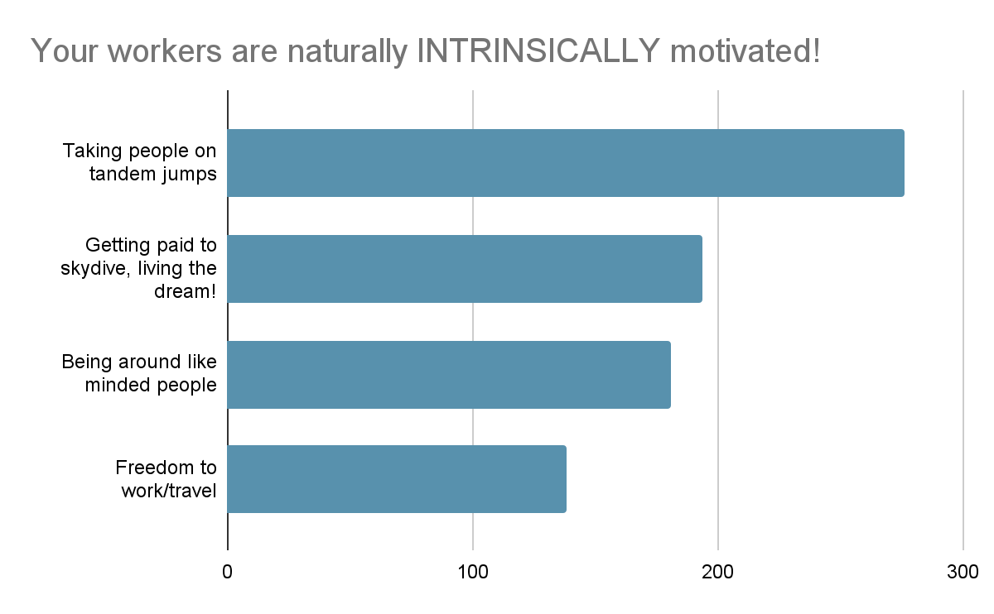
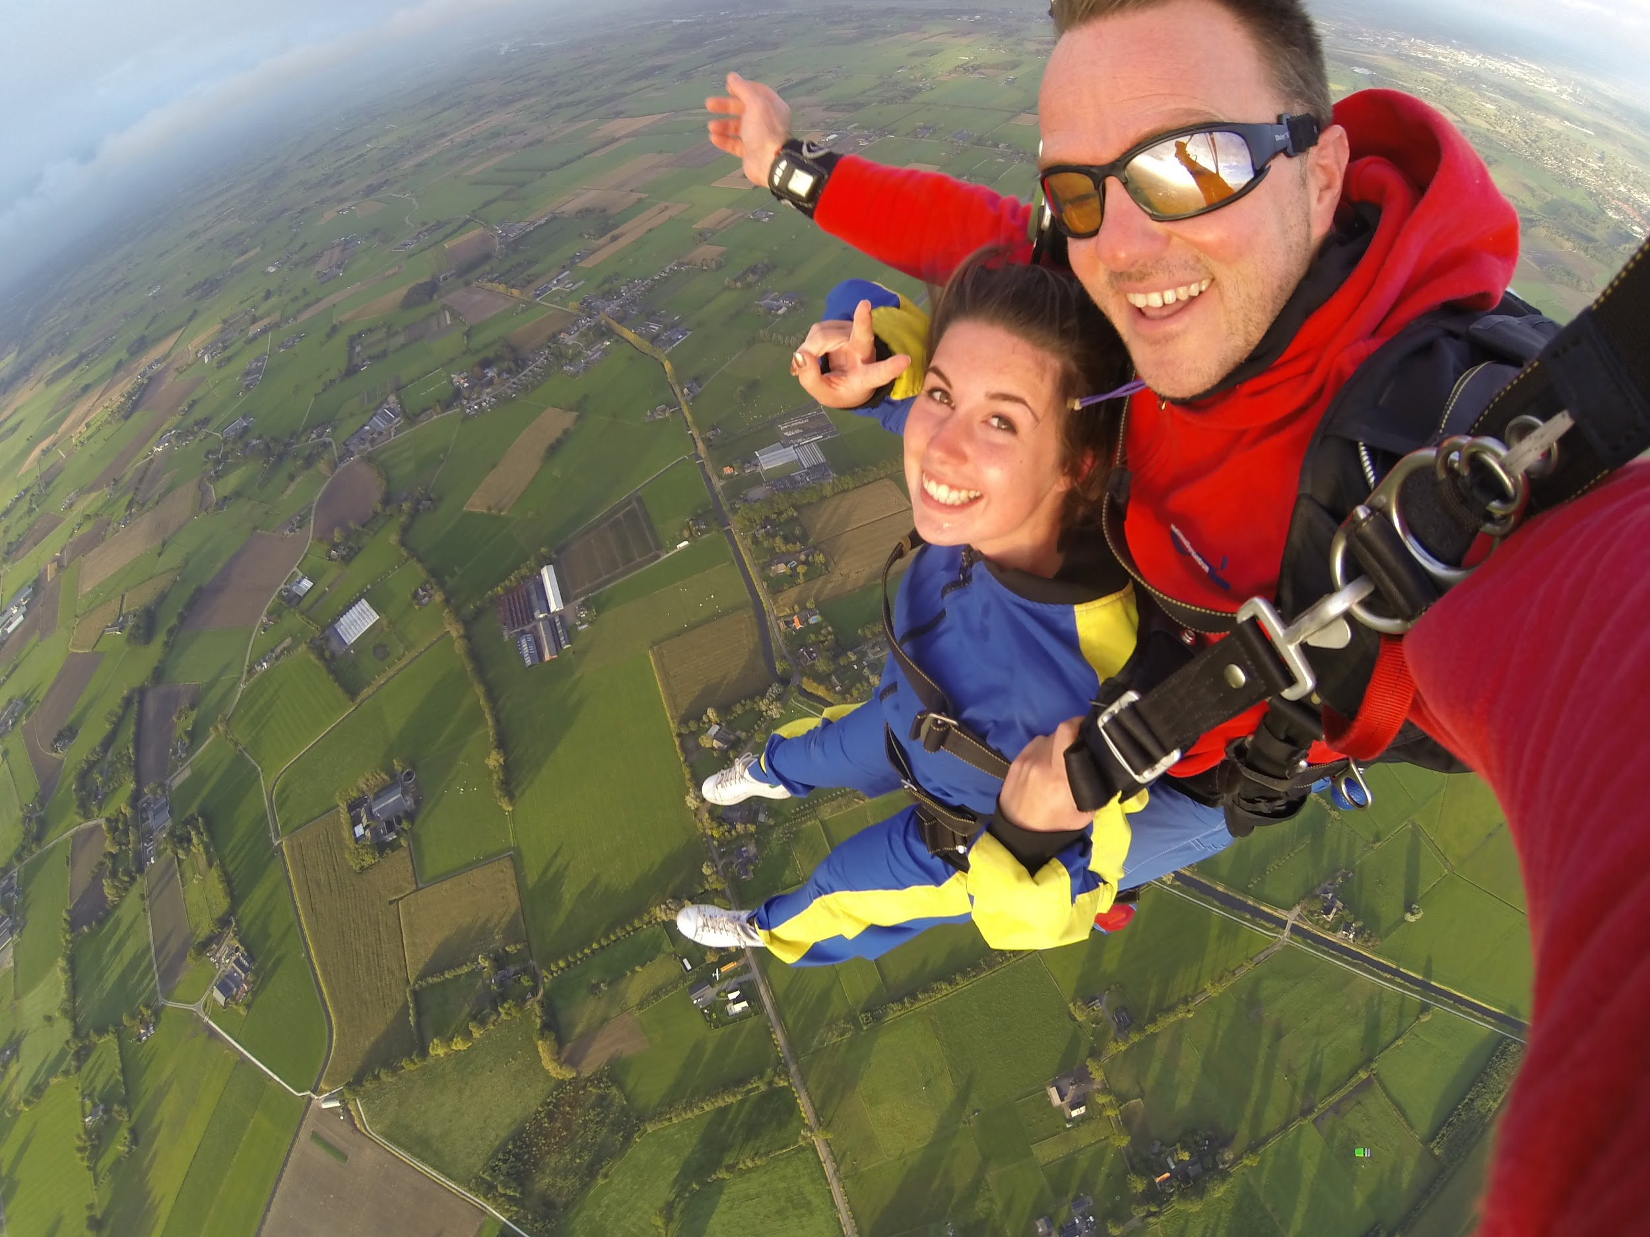
Survey Question:
What is your favorite part about being a tandem instructor?

Slide 8
How do you attract tandem instructors to work at your dropzone?
Survey Question:
What are the most important factors in
making a drozone worth working for?

Slide 9
Work conditions
This includes the quality of the equipment, the aircraft and the experience level of their peers (quick solution jump inspection = less malfunctions)
Clear communication
Management that is considerate, transparent, and supportive
Money
Being paid a fair rate, having a generous tip policy, and financial incentives
Other
Flexible scheduling, recognition, room for growth, etc.

Slide 10
The average life cycle is 3 years
2019 | 2020 | 2021 | 2022 | 2023 | 2024 | 2025 | 2026
Global go-live
Work Conditions
Provide good conditions, communication, $$
Clear Communication
Money $$
Mentorship

Slide 11
Survey Question: In your opinion, what is the appropriate pay for a tandem instructor in 2023? (Your opinion will hold no bearing on actual pay. I am simply asking to get an industry average to share as part of this survey)
NOTE: REALISTIC figures will serve the purpose better than outrageous ones
Tandem pay per jump
Handcam pay per jump
Overweight pay per jump
Annual bonus/incentive
80% responses 50/50 flat rate v pay per lbs Average flat rate $26, $1 per pound 210+ lbs consensus to be “overweight”
89% responses/problem: # of clips Low $15 High $60 Average $30
45% responses Average $1,200 per year $2 per jump
100% responses Low $35 High $75 Average $50
1
2
3
4
FOR INFORMATIONAL PURPOSES ONLY!

Slide 12
“CLIENTS DO NOT COME FIRST. EMPLOYEES COME FIRST. IF YOU TAKE CARE OF YOUR EMPLOYEES, THEY WILL TAKE CARE OF THE CLIENTS.”​
–RICHARD BRANSON

Slide 13
QUESTIONS?

