Slide 1
Authentic Marketing using Visual Representation

Slide 2
What is Visual Representation?
Visual Representation means any visual depiction, including any photograph, film, video, digital image, picture, or computer or computer-generated image or picture, whether made or produced by electronic, mechanical, or other means.
Visual marketing is the use of images, videos, and other pieces of multimedia content to strengthen your brand and communicate with your target audience. As part of a larger marketing strategy, it helps you depict certain subjects and concepts that would otherwise be harder to approach by using only text
In recent research, 10,000 consumers were surveyed around the world to uncover people’s attitudes towards visual representation.
•Eight in ten people globally expect that companies and brands will be consistently committed to inclusivity and diversity in their advertising.
•Six in 10 respondents said they prefer to buy from brands that are founded by or represent people like themselves.
These findings reveal that it is increasingly important for consumers that the brands they interact with reflect their values, and this means representing diverse audiences in a brand’s visual communications

Slide 3
Why is visual representation so important?
Have you ever heard of the old saying: ‘A picture is worth ten thousand words’? Our eyes can register as many as 36,000 visual messages every hour.
People only remember about 10-20%% of what they read, but up to 65% of what they see.
Visual images to strengthen your brand and communicate with your target audience. As part of a larger marketing strategy, it helps you depict certain subjects and concepts that would otherwise be harder to approach by using only text.
. Visual content also increases engagement by 180%, proving that visuals not only help us process information more quickly, but they also evoke an emotional response.

Slide 4
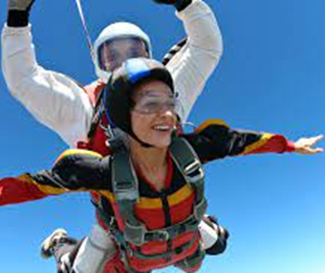
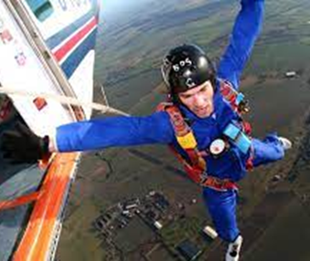
Visual Representation on UK DZ Websites
Photographs used on websites
Gender
•Main Page: 40% female 60% male (excluding instructor)
•Tandem Page: 53% Female 47% male (excluding instructor)
•AFF/CS Page: 35% Female 65% male
•Sport Jumping: 0% Female
Race
•White: 98%
•Person on colour : 2%

Slide 5
Examples of visual representation in underrepresented sectors

Slide 6
Website for teaching

Slide 7
Teaching statistics
UK population Gendre Female - 51% Male - 49% Ethnicity: White – 87.2% Mixed/Asian/Black - 9.2% Other: 3.7%
Teachers in 2021
Male
14.1% primary,
35.5% secondary
Female
85.9% primary
64.5% secondary
Ethnicity
White = 83%
BAME: 17%
Website – Get into Teaching
Main page and all tabbed pages
Male
50% - 12/24
Female
50% - 12/24
Ethnicity
White = 58% 14/24
BAME= 42% 10/24

Slide 8
WEBSITE FOR NHS CAREERS - NURSING

Slide 10
Impact of visual representation on nursing
11% of Registered Nurses in the UK identify as male. 89% identify as female
A record breaking number of male school leavers applied to be nurses following NHS England’s successful “We Are The NHS” recruitment campaign.
Since last year, there has been a total 9% jump in men applying to study nursing, showing that attitudes are changing towards a career that has often wrongly been portrayed as a female profession.

Slide 11
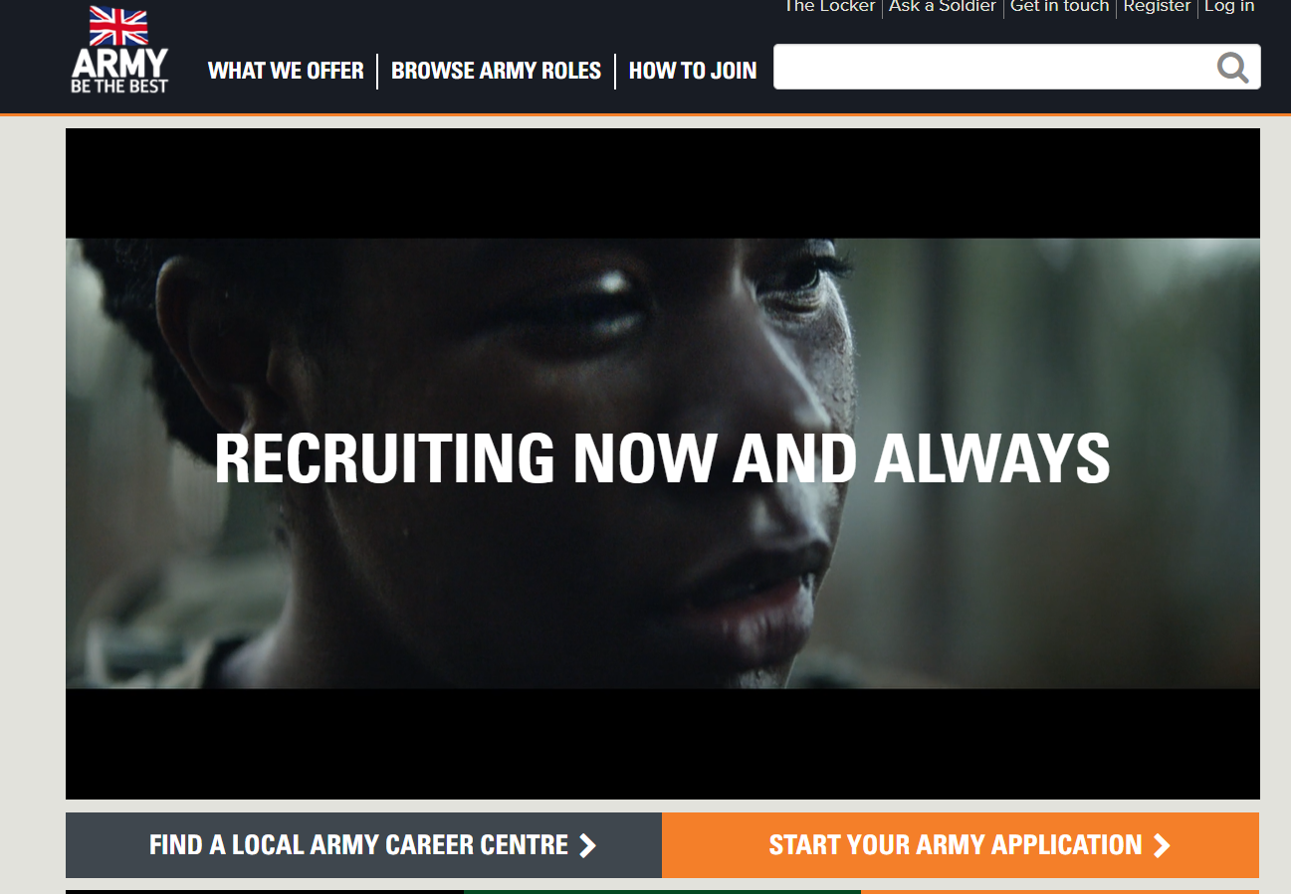
Visual representation in the army
Army Statistics
10.9% female
89.1% Male
8.8% BAME
92.2% White
Website:
Home Page: 50%male/female ratio
Video: 50% female/male, and 50% BAME/white ratio

Slide 12
Skydiving APF #Getintoskydiving Campaign

Slide 13
British Skydiving Statistics & What is Possible?

Slide 14
Skydive Langar – Burble statistics
AFF Students Statistics 2021
Potential Reasons:
Social Media
DZ culture/Safety
Location / university connections
High number female instructors/camera fliers/staff
Male | Female
93 = 72% | 36 = 28%
Registered Sports Jumpers
Male | Female
392 = 74% | 141 = 26%

Slide 15
Visual representation and inclusivity – The effect on a uk dropzone
Actions
Social Media – Visual Representation
Tandem Briefs in other languages
Interpreter
Staff - Languages
Awareness/advertising on other popular social media platforms
Actively looking to increase female staff in particular tandem instructors
Increase Business
Up to 60% Mid-week - POC
20% Weekend - POC
Slow increase in AFF
Significant increase in video sales and merchandise sales
Significant increase in tandem numbers/business revenue

Slide 17
VISUAL REPRESENTATION ON Uspa DZ WEBSITES in the united states
Front Page
90% female, 100% male
100% White / 45% Person of Colour
AFF front page section – 28% female included, 72% only included men in this section
Tandem Page
Approx 50% male/female ratio of pictures used
43% had person of colour
AFF Tab
14 websites, only 2 had photo's of women in the AFF section (14%)
28 % of the websites - Person of colour
No one website had any visual representation of anyone with an obvious physical disability
VISUAL REPRESENTATION ON UK DZ WEBSITES

Slide 18
Possible actions
Self Audits (Initial and review)
Online Course - Inclusive marketing
Marketing Support
Inclusivity marketing strategy

