Slide 1
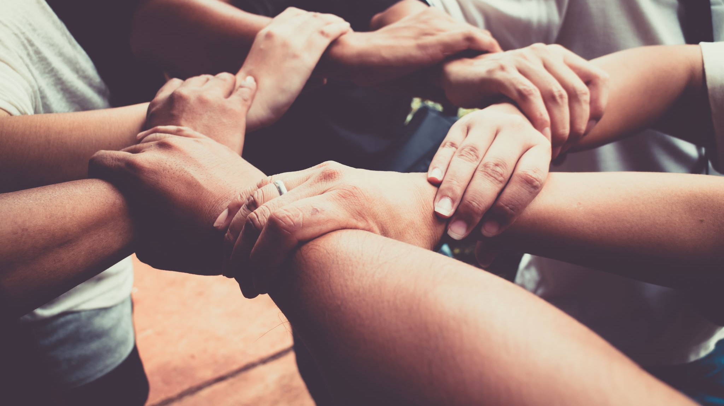
“Teams succeed because they are exceedingly human.”
- Patrick Lencioni
Notes:
Teamwork can be the single most important skill and business process in making your organization effective and better than the competition.
- Alex Kowtun, Forbes Magazine, 2020

Slide 2
A team is a group of people with complementary skills who are committed to a common purpose, performance goals, and approach for which they hold themselves mutually accountable.
High performing teams exceed expectations by modeling extreme ownership, transparent communication, and integrated collaboration, all of which is based on a foundation of deep trust.
What is a
High-Performing
Team?
For Internal Use Only © Copyright Cascade Leadership Partners, LLC 2023 | 2

Slide 3
WHAT
Knowledge / Skills / Abilities
Competence
Reliability
Say / Do Ratio
Trust
TRUST
Sincerity, Share what I’m thinking/ feeling
I have your back; care for your priorities / agenda
Authenticity
Care
HOW
For Internal Use Only © Copyright Cascade Leadership Partners, LLC 2023 | 3

Slide 4
Trust Accelerators
Being Vulnerable
Receiving AND Giving Feedback
Notes:
Two hacks for accelerating Trust
Going to talk about each of these, then give you a chance to practice and feel

Slide 5
Being Vulnerable
Why does “being vulnerable” accelerate trust?
Because it establishes intimacy and emotional connection – we feel seen, heard, and understood
What does “being vulnerable” look like?
Being open and honest about one’s feelings, thoughts, and experiences
How can you facilitate this with your team?
Creating a safe place for team members to be vulnerable – to authentically be themselves

Slide 6
Being Vulnerable: An exercise in self-disclosure
Red Pairs and Black Pairs
5 min total (2 min per person)
Share:
One unfulfilled hope or dream
AND
What it feels like to want this?

Slide 7
Being Vulnerable: An exercise in self-disclosure
What feelings did that exercise evoke for you, or what observations can you share about yourself?

Slide 8
Receiving & Giving Feedback
Why does receiving and giving feedback accelerate trust?
Because it demonstrates humility and care, respectively
What do receiving and giving feedback look like?
Being open and receptive without taking offense
Providing an objective reflection of the impact the recipient’s behavior is having on others
How can you facilitate this with your team?
Creating a safe and structured environment for regular and intentional feedback exchange
Notes:
One challenge with effectively Receiving is that many people are practiced at effectively Giving.

Slide 9
Depersonalize
Trust the intent
Questions for clarity
No discussion, no debate
Say “Thank You”
Gratitude is not Agreement
Rules for Receiving Feedback

Slide 10
Rules and Tools for Giving Feedback
The Rules:
Be Direct – “Go Through the Front Door”
Be Clear - “Brevity is Clarity”
Depersonalize – “Objective observations”
Watchout – for The Vice of Advice!!
The Tools:
Situation, Behavior, Impact (SBI)
Powerful Requests

Slide 11
Powerful Requests
“I need ___________ because _________.”
“I want/would like ___________ because _________.”
“Can you ___________ because ________.”

Slide 12
Giving Feedback: An exercise of care
Different Red and Black Pairs
5 min total (2 min per person)
Use SBI and a Powerful Requests to:
Communicate a challenging message that you really need to give someone.
(no need to set the context)

Slide 13
Giving Feedback: An exercise of care
As the giver, what was it like communicating in that way?
As the receiver, what was it like listening in that way?

Slide 14
An Invitation
“What is ONE thing you will do next week to strengthen the trust within your team?”
“I will ___________ with ________ by ___________.”
(Complete the above statement, in writing, and share with someone here in Reno who you can follow up with 2 weeks and 3 months from now.)

Slide 15
Onward
and
Upward
www.shannonpilcher.com
shannon@shannonpilcher.com

